Slide 1
Lecture 25
Composite hypotheses

Slide 2
Review

Slide 3
Testing a mean: σ known
when to use it
σ is known; a random sample from a normal population, or n ≥ 30
test statistic
z_{obs} = (x̄ − μ₀) / (σ/√n)
if H₀ is true
z_{obs} ~ N(0, 1), standard normal
P-value
from the z-table, e.g. P(Z ≥ z_{obs} | H₀ true) if upper-tailed

Slide 4
Testing a mean: σ unknown
when to use it
σ is unknown, so we estimate it with the sample SD s
test statistic
t_{obs} = (x̄ − μ₀) / (s/√n), df = n − 1
if H₀ is true
t_{obs} ~ t(n − 1), Student’s t: heavier tails than N(0, 1)
P-value from the t-table
find t_{obs} between two values in row df; P is between their tail areas

Slide 5
Example: Marco’s throwing distance
Marco, a high school quarterback, throws a football a mean of 40 yards, with σ = 2. His coach has him adjust his grip and records 20 throws. Distances are normal. (OpenStax, Try It 9.14)
n = 20; x̄ = 45 yards; σ = 2; μ₀ = 40; α = 0.05
(a) What are H₀ and H_{A}? Which tail? z or t?
(b) What are the standard error and the test statistic?
(c) What is the P-value? What is the decision?
(d) What is the critical value? Does z_{obs} fall in the rejection region?
(a) H₀: μ = 40 H_{A}: μ > 40, upper-tailed; σ known, so z
(b) SE = 2 / √20 ≈ 0.4472; z_{obs} = (45 − 40) / 0.4472 ≈ 11.18
(c) P(Z ≥ 11.18 | H₀ true) ≈ 0 < 0.05: reject H₀
(d) Z_{0.95} = 1.645; z_{obs} = 11.18 ≥ 1.645, in the rejection region: reject H₀

Slide 6
Example: the first statistics test
Students believe the mean score on the first statistics test is 65. An instructor thinks it is higher and samples 10 students’ scores, which are normal. (OpenStax, Example 9.16)
n = 10; x̄ = 67; s = 3.197; μ₀ = 65; α = 0.05
(a) What are H₀ and H_{A}? Which tail? Are the assumptions met?
(b) z or t? What are the standard error and the test statistic?
(c) What is the P-value (use the t-table)? What is the decision?
(d) What is the critical value? Does t_{obs} fall in the rejection region?
(a) H₀: μ = 65 H_{A}: μ > 65, upper-tailed; n < 30, but the scores are normal
(b) σ unknown, so t; SE = 3.197 / √10 ≈ 1.011; t_{obs} = (67 − 65) / 1.011 ≈ 1.98, df = 9
(c) row 9: 1.833 < 1.98 < 2.262, so 0.025 < P-value < 0.05: reject H₀
(d) t_{9, 0.95} = 1.833; t_{obs} = 1.98 ≥ 1.833, in the rejection region: reject H₀

Slide 7
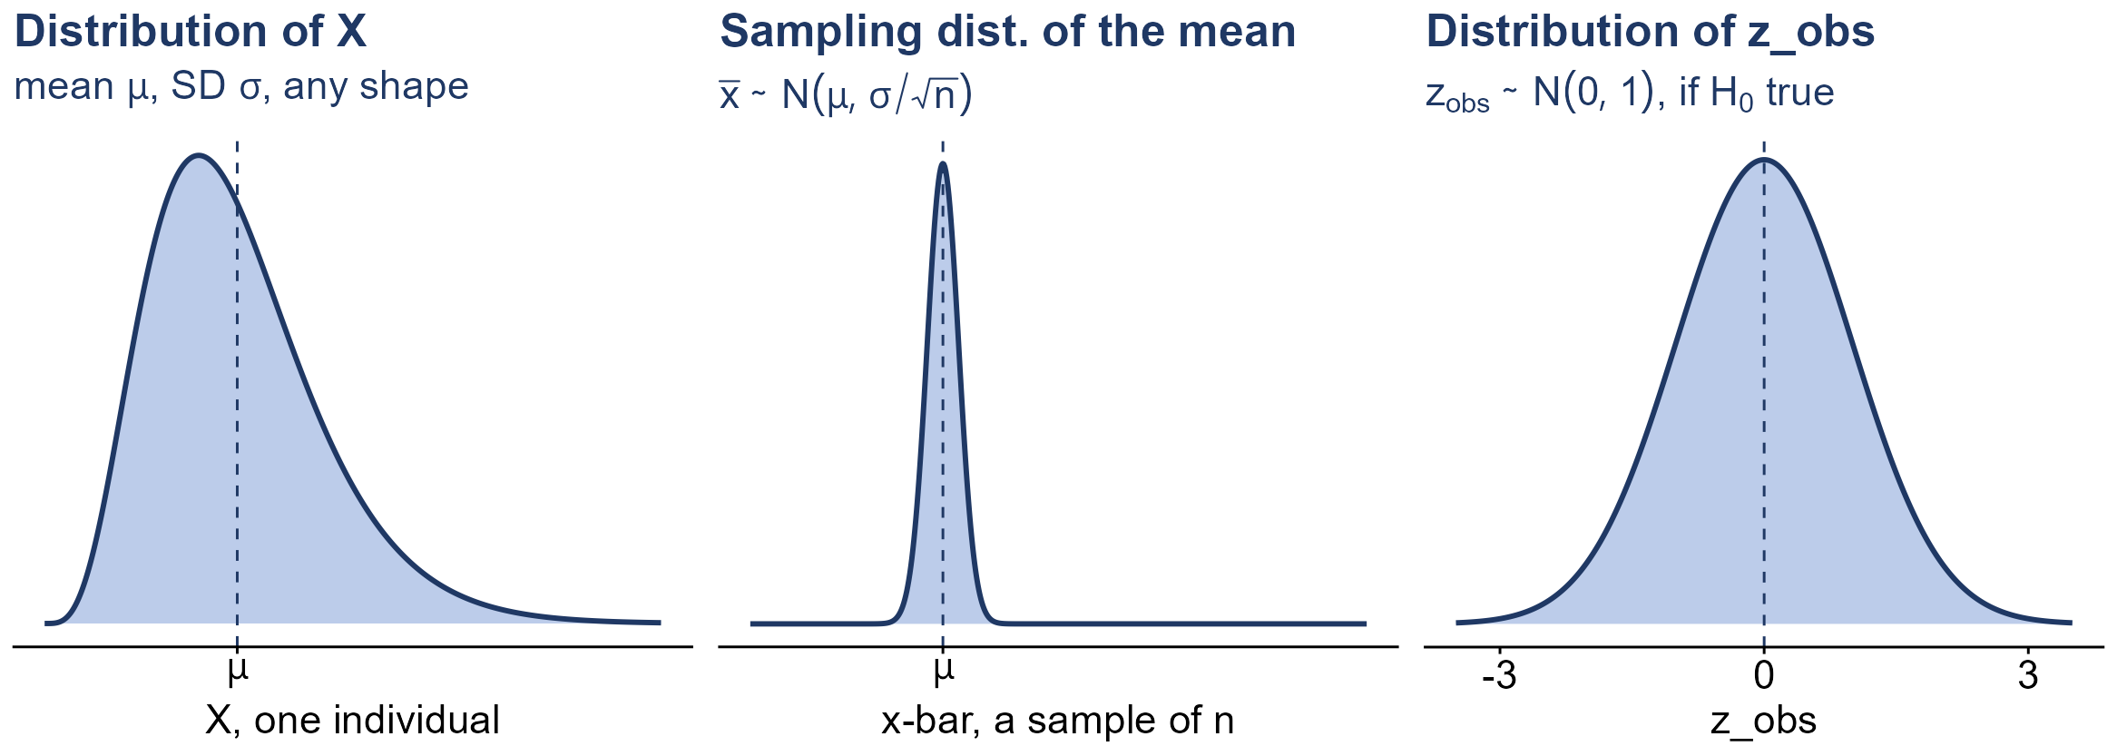
Three distributions: a mean

Slide 8
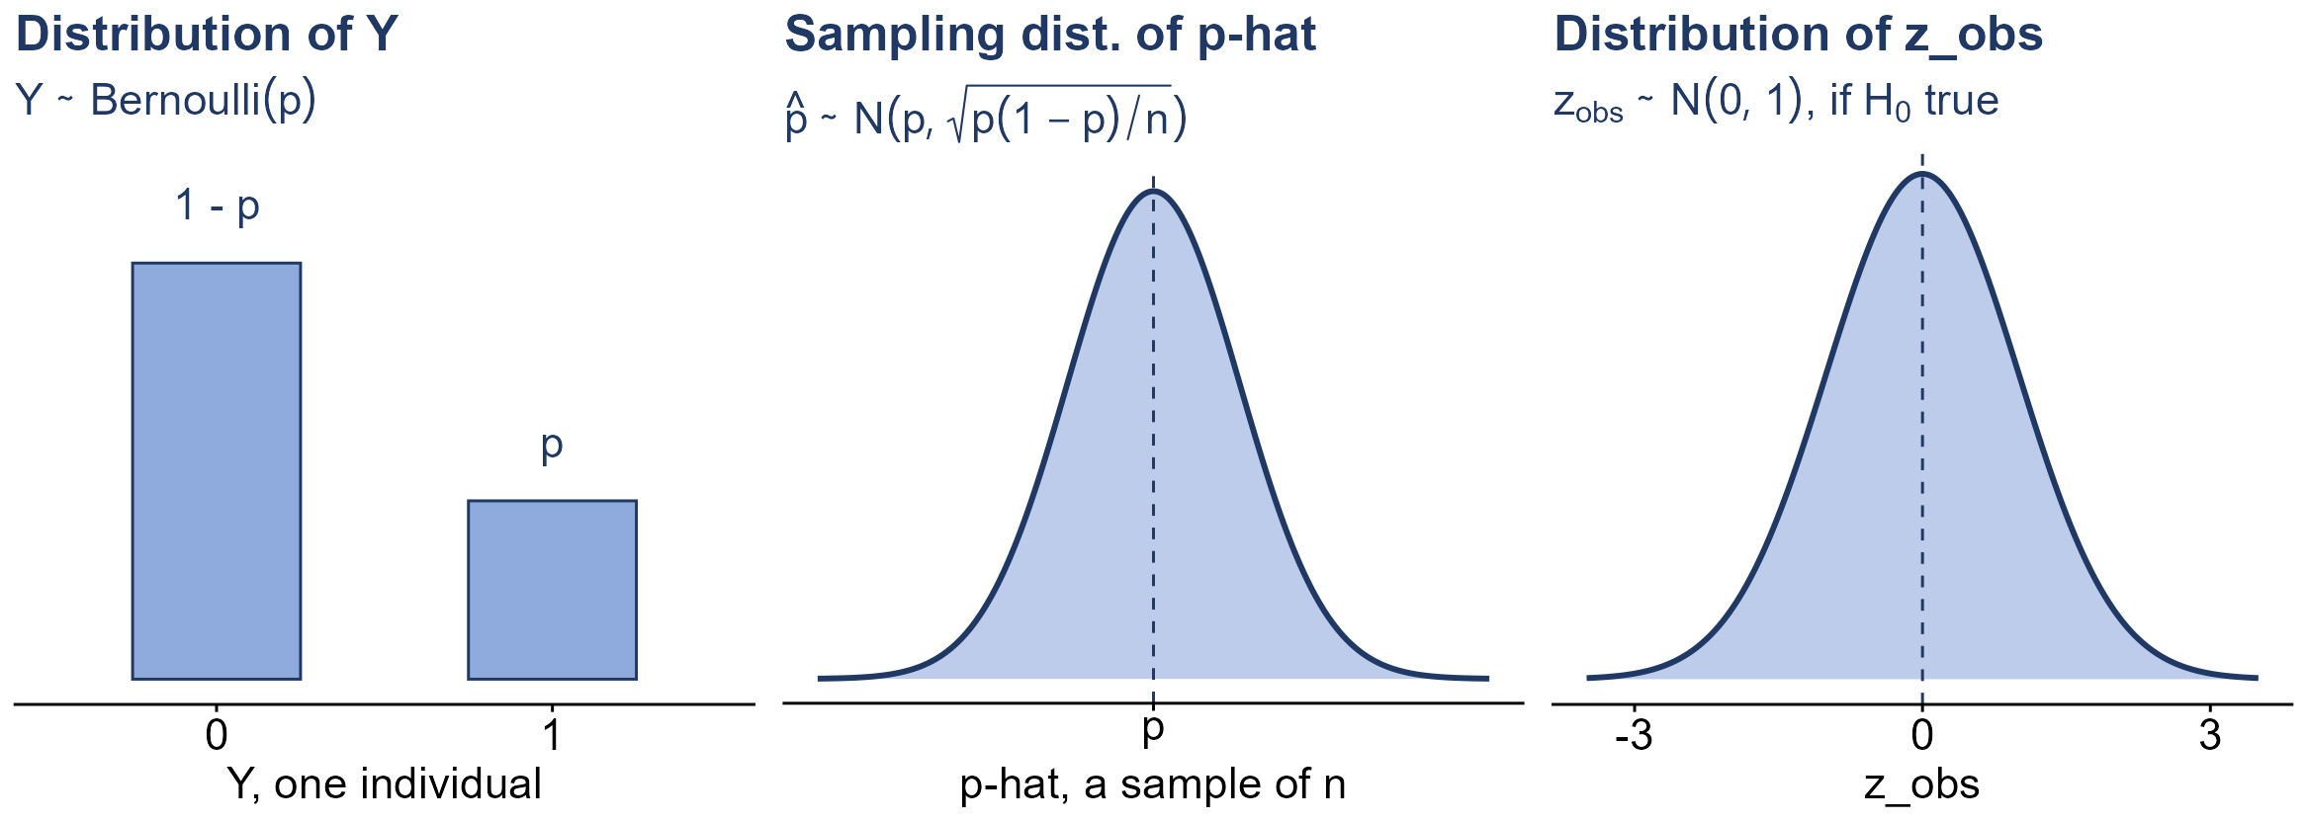
Three distributions: a proportion

Slide 9
Why is z_{obs} standard normal?
a z-score
(value − mean of its distribution) / SD; ~ N(0, 1) if the value is normal
if H₀ is true
μ = μ₀, so x̄ ~ N(μ₀, σ/√n)
so z_{obs} is a z-score
z_{obs} = (x̄ − μ₀) / (σ/√n) is the z-score of x̄: ~ N(0, 1)
if H₀ is false
z_{obs} is centred at (μ − μ₀) / (σ/√n), away from 0

Slide 10
Example: the bench press
A coach’s records say his players bench press a mean of 275 pounds, with σ = 55. Three players think it is more and ask 30 teammates. (OpenStax, Example 9.15)
n = 30; x̄ = 286.17; σ = 55; μ₀ = 275; α = 0.025
(a) If H₀: μ = 275 is true, what is the distribution of x̄?
(b) How many SDs above 275 is x̄? What is z_{obs}?
(c) What is the P-value for H_{A}: μ > 275? What is the decision?
(a) x̄ ~ N(275, 55/√30) = N(275, 10.04), normal
(b) (286.17 − 275) / 10.04 ≈ 1.11 SDs: z_{obs} = 1.11
(c) P(Z ≥ 1.11 | H₀ true) = 1 − 0.8665 = 0.1335 ≥ 0.025: do not reject H₀

Slide 11
Composite hypotheses
simple hypothesis
names one value of the parameter: H₀: θ = θ₀
composite hypothesis
allows a range of values: H₀: θ ≤ θ₀ or H₀: θ ≥ θ₀
H₀ always has the equals sign
=, ≤ or ≥ (H_{A} never does); a two-sided test always uses H₀: θ = θ₀
test at the boundary
compute z_{obs} or t_{obs} with θ₀, the edge of H₀: the hardest value to reject

Slide 12
Practice: voter turnout
A county election official reports that no more than 30% of the registered voters in Santa Clara County voted in the primary election. A local newspaper suspects turnout was higher, and surveys a random sample of registered voters. (OpenStax, Example 9.1)
the official’s figure: no more than 30% voted
(a) What is the parameter, in words?
(b) State H₀ and H_{A}.
(c) Is H₀ simple or composite? Which tail?
(a) p = the proportion of all registered voters in the county who voted in the primary
(b) H₀: p ≤ 0.30 H_{A}: p > 0.30
(c) composite; upper-tailed, tested at the boundary p₀ = 0.30

Slide 13
Practice: time to graduate
College students are often told a degree takes five years, on average. An advising office believes its students finish faster, and records how long a random sample of recent graduates took to graduate. (OpenStax, Example 9.3)
the usual figure: 5 years, on average
(a) What is the parameter, in words?
(b) State H₀ and H_{A}.
(c) Is H₀ simple or composite? Which tail?
(a) μ = the mean time to graduate for all of the college’s students
(b) H₀: μ ≥ 5 H_{A}: μ < 5
(c) composite; lower-tailed, tested at the boundary μ₀ = 5

Slide 14
Practice: a cure-rate claim
A drug company advertises that its experimental drug cures at least 75% of men with prostate cancer. An independent research group suspects the true cure rate is lower, and follows a random sample of patients who took the drug. (OpenStax, Example 9.8)
the company’s claim: a cure rate of at least 75%
(a) What is the parameter, in words?
(b) State H₀ and H_{A}.
(c) Is H₀ simple or composite? Which tail?
(a) p = the proportion of all men with prostate cancer who are cured by the drug
(b) H₀: p ≥ 0.75 H_{A}: p < 0.75
(c) composite; lower-tailed, tested at the boundary p₀ = 0.75

Slide 15
Example: the conductivity of glass
NIST measures the conductivity of 11 randomly selected pieces of a type of glass. Is the mean greater than 1? The population is normal. (OpenStax, Example 9.20)
n = 11; x̄ = 1.04; s = 0.0659; α = 0.05
(a) What are H₀ and H_{A}? Which value of μ do we test at?
(b) What are the standard error and t_{obs}?
(c) What is the P-value (use the t-table)? What is the decision?
(a) H₀: μ ≤ 1 (composite) H_{A}: μ > 1; test at the boundary, μ₀ = 1
(b) SE = 0.0659 / √11 ≈ 0.0199; t_{obs} = (1.04 − 1) / 0.0199 ≈ 2.01, df = 10
(c) row 10: 1.812 < 2.01 < 2.228, so 0.025 < P-value < 0.05: reject H₀

Slide 16
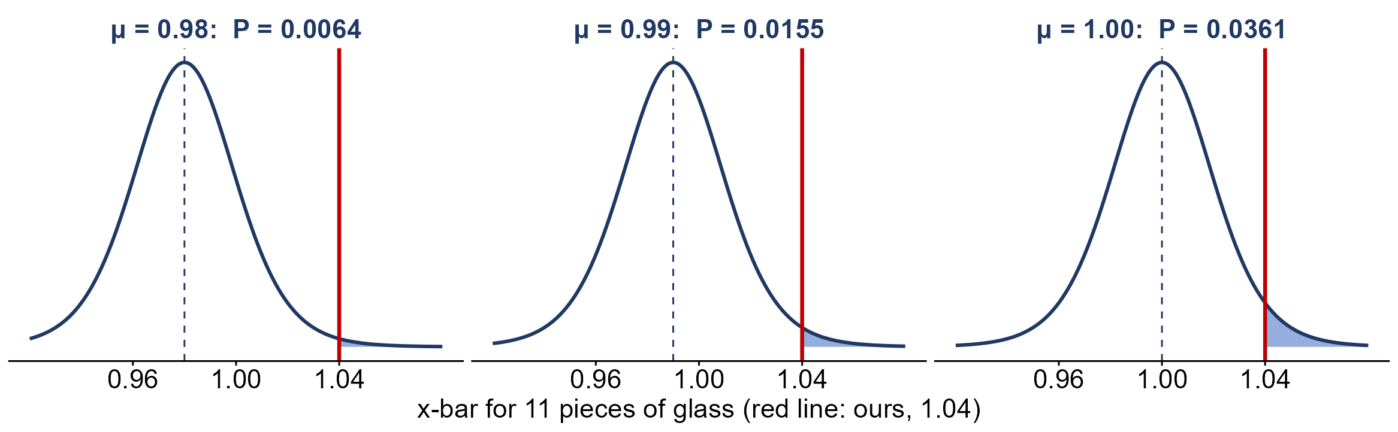
Why test at the boundary?
Largest P-value at the boundary μ = 1: reject there, and we reject all of H₀

Slide 17
Example: the baker’s bread
A baker claims his bread rises more than 15 cm, on average. His customers doubt it, so he bakes 10 loaves. Heights are normal. (OpenStax, Example 9.9)
n = 10; x̄ = 17 cm; σ = 0.5 cm; α = 0.05
(a) What are H₀ and H_{A}? z or t?
(b) What are the standard error and the test statistic?
(c) What is the P-value? What is the decision?
(a) H₀: μ ≤ 15 H_{A}: μ > 15, test at μ₀ = 15; σ known, so z
(b) SE = 0.5 / √10 ≈ 0.1581; z_{obs} = (17 − 15) / 0.1581 ≈ 12.65
(c) P(Z ≥ 12.65 | μ = 15) ≈ 0 < 0.05: reject H₀; the loaves average more than 15 cm

Slide 18
Practice: is the mean greater than 12?
A normal population has σ = 1. We want to verify a claim that its mean is greater than 12. (OpenStax, Try It 9.9)
n = 36; x̄ = 12.5; σ = 1; α = 0.05
(a) What are H₀ and H_{A}?
(b) What are the standard error and z_{obs}?
(c) What is the P-value? What is the decision?
(a) H₀: μ ≤ 12 H_{A}: μ > 12, test at μ₀ = 12
(b) SE = 1 / √36 ≈ 0.1667; z_{obs} = (12.5 − 12) / 0.1667 = 3.00
(c) P(Z ≥ 3.00 | μ = 12) = 1 − 0.9987 = 0.0013 < 0.05: reject H₀

